Slide 1
Principles of
Operating Systems
Lectures 10,11,12 and13 - Memory Management

Slide 2
Outline
Background
Logical versus Physical Address Space
Swapping
Contiguous Allocation
Paging
Segmentation
Segmentation with Paging

Slide 3
Background
Program must be brought into memory and placed within a process for it to be executed.
Input Queue - collection of processes on the disk that are waiting to be brought into memory for execution.
User programs go through several steps before being executed.

Slide 4
Names and Binding
  Symbolic names → Logical names → Physical names
    Symbolic Names: known in a context or path
      file names, program names, printer/device names, user names
    Logical Names: used to label a specific entity
      inodes, job number, major/minor device numbers, process id (pid), uid, gid..
    Physical Names: address of entity
      inode address on disk or memory
      entry point or variable address
      PCB address

Slide 5
Binding of instructions and data to memory
  Address binding of instructions and data to memory addresses can happen at three different stages.
    Compile time:
      If memory location is known apriori, absolute code can be generated; must recompile code if starting location changes.
    Load time:
      Must generate relocatable code if memory location is not known at compile time.
    Execution time:
      Binding delayed until runtime if the process can be moved during its execution from one memory segment to another. Need hardware support for address maps (e.g. base and limit registers).

Slide 6
Binding time tradeoffs
  Early binding
      compiler - produces efficient code
      allows checking to be done early
      allows estimates of running time and space
  Delayed binding
      Linker, loader
      produces efficient code, allows separate compilation
      portability and sharing of object code
  Late binding
      VM, dynamic linking/loading, overlaying, interpreting
      code less efficient, checks done at runtime
      flexible, allows dynamic reconfiguration

Slide 7
Dynamic Loading
Routine is not loaded until it is called.
Better memory-space utilization; unused routine is never loaded.
Useful when large amounts of code are needed to handle infrequently occurring cases.
No special support from the operating system is required; implemented through program design.

Slide 8
Dynamic Linking
Linking postponed until execution time.
Small piece of code, stub, used to locate the appropriate memory-resident library routine.
Stub replaces itself with the address of the routine, and executes the routine.
Operating system needed to check if routine is in processes’ memory address.

Slide 9
Logical vs. Physical Address Space
    Physical Address: address seen by memory unit.
    Logical Address: or virtual address - generated by CPU
  Logical and physical addresses are the same in compile time and load-time binding schemes
  Logical and physical addresses differ in execution-time address-binding scheme.

Slide 10
Memory Management Unit (MMU)
Hardware device that maps virtual to physical address.
In MMU scheme, the value in the relocation register is added to every address generated by a user process at the time it is sent to memory.
The user program deals with logical addresses; it never sees the real physical address.

Slide 11
Swapping
  A process can be swapped temporarily out of memory to a backing store and then brought back into memory for continued execution.
      Backing Store - fast disk large enough to accommodate copies of all memory images for all users; must provide direct access to these memory images.
      Roll out, roll in - swapping variant used for priority based scheduling algorithms; lower priority process is swapped out, so higher priority process can be loaded and executed.
      Major part of swap time is transfer time; total transfer time is directly proportional to the amount of memory swapped.

Slide 12
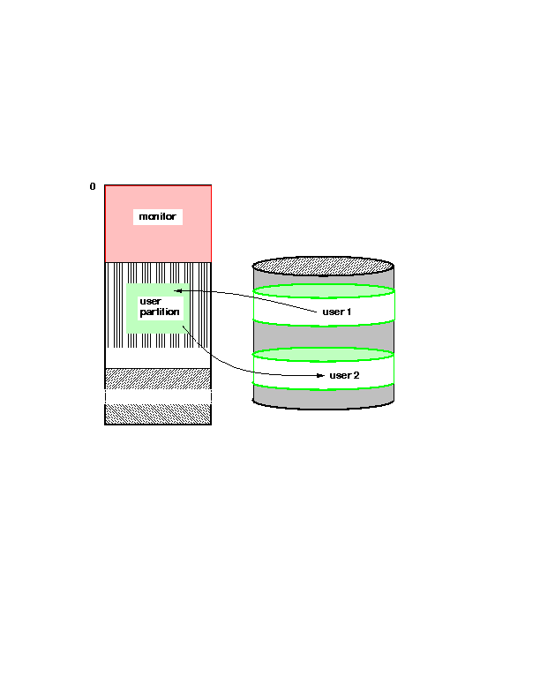
Schematic view of swapping

Slide 13
Contiguous Allocation
Main memory usually divide into two partitions
    Resident OS, usually held in low memory with interrupt vector.
    User processes then held in high memory.
Single partition allocation
    Relocation register scheme used to protect user processes from each other, and from changing OS code and data.
    Relocation register contains value of smallest physical address; limit register contains range of logical addresses - each logical address must be less than the limit register.

Slide 14
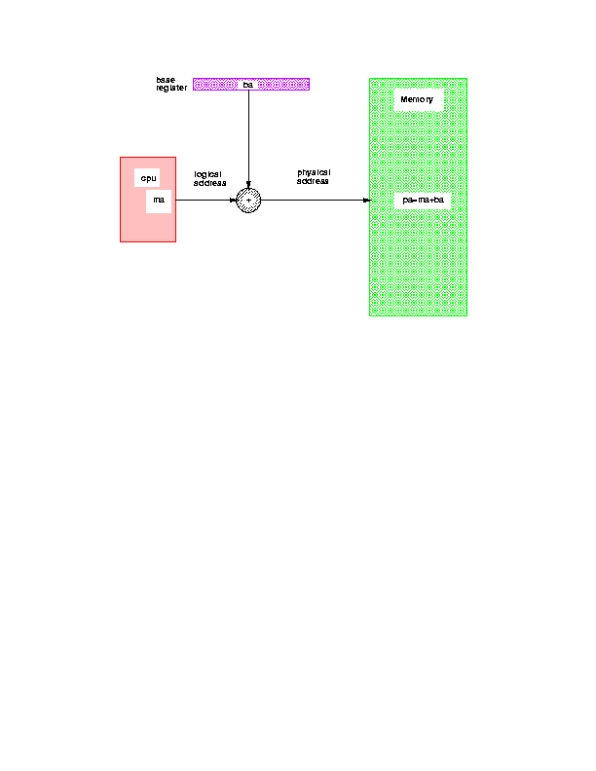
Relocation Register
Base register (ba)
Memory
CPU
Base register
Logical
address
(ma)
Physical
address
(pa)
pa = ba + ma

Slide 15
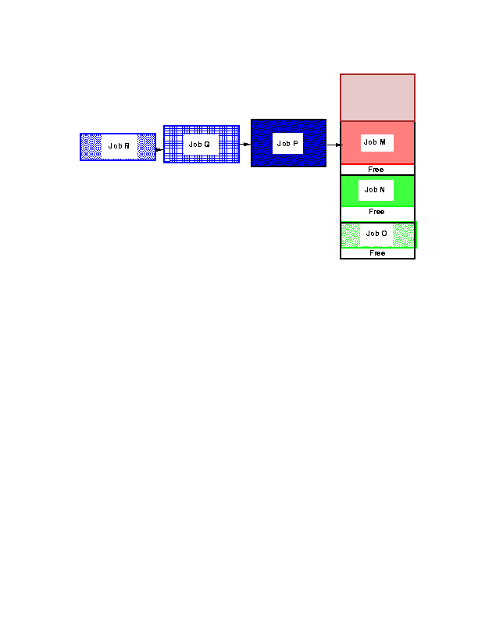
Fixed partitions

Slide 16
Contiguous Allocation (cont.)
Multiple partition Allocation
    Hole - block of available memory; holes of various sizes are scattered throughout memory.
    When a process arrives, it is allocated memory from a hole large enough to accommodate it.
    Operating system maintains information about
      allocated partitions
      free partitions (hole)

Slide 17
Contiguous Allocation example
OS
OS
OS
OS
Process 5
Process 5
Process 5
Process 5
Process 9
Process 9
Process 8
Process 10
Process 2
Process 2
Process 2
Process 2

Slide 18
Dynamic Storage Allocation Problem
  How to satisfy a request of size n from a list of free holes.
    First-fit
      allocate the first hole that is big enough
    Best-fit
      Allocate the smallest hole that is big enough; must search entire list, unless ordered by size. Produces the smallest leftover hole.
    Worst-fit
      Allocate the largest hole; must also search entire list. Produces the largest leftover hole.
  First-fit and best-fit are better than worst-fit in terms of speed and storage utilization.

Slide 19
Fragmentation
    Internal fragmentation
      allocated memory may be slightly larger than requested memory; this size difference is memory internal to a partition, but not being used.
    External fragmentation
      total memory space exists to satisfy a request, but it is not contiguous.
      Reduce external fragmentation by compaction
        Shuffle memory contents to place all free memory together in one large block
        Compaction is possible only if relocation is dynamic, and is done at execution time.

Slide 20
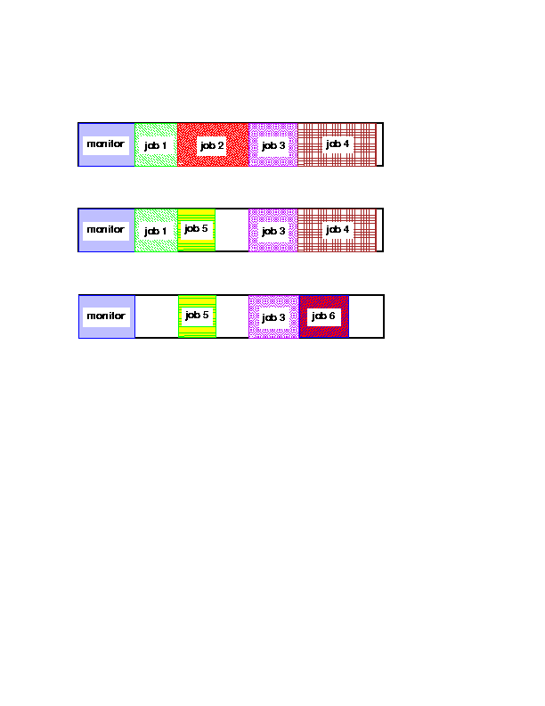
Fragmentation example

Slide 21
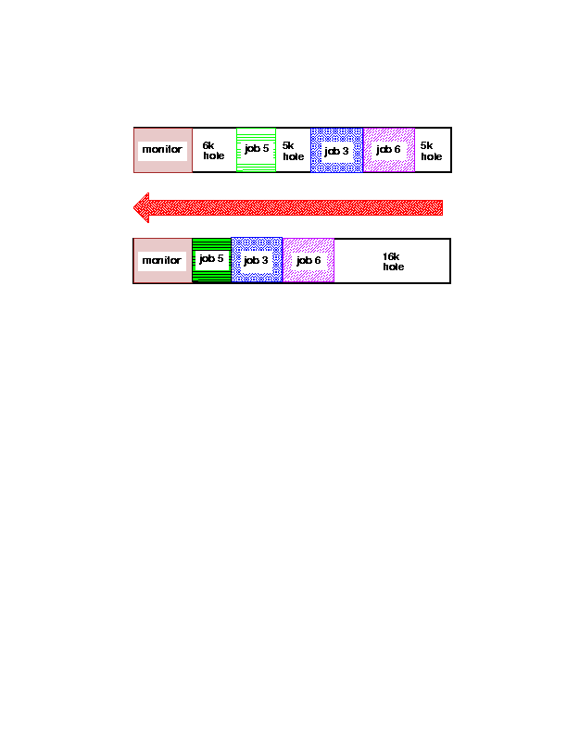
Compaction

Slide 22
Paging
Logical address space of a process can be non-contiguous;
      process is allocated physical memory wherever the latter is available.
    Divide physical memory into fixed size blocks called frames
      size is power of 2, 512 bytes - 8K
    Divide logical memory into same size blocks called pages.
      Keep track of all free frames.
      To run a program of size n pages, find n free frames and load program.
    Set up a page table to translate logical to physical addresses.
    Note:: Internal Fragmentation possible!!

Slide 23
Address Translation Scheme
Address generated by CPU is divided into:
    Page number(p)
      used as an index into page table which contains base address of each page in physical memory.
    Page offset(d)
      combined with base address to define the physical memory address that is sent to the memory unit.

Slide 24
Address Translation Architecture
Physical
Memory
CPU
p
d
f
d
:
p
f
:

Slide 25
Example of Paging
Logical memory
Physical memory
Page 0
Page 0
Page 1
Page 2
Page 1
0
1
Page 2
1
3
Page 3
2
4
Page 3
3
7
:
:

Slide 26
Page Table Implementation
Page table is kept in main memory
    Page-table base register (PTBR) points to the page table.
    Page-table length register (PTLR) indicates the size of page table.
  Every data/instruction access requires 2 memory accesses.
    One for page table, one for data/instruction
    Two-memory access problem solved by use of special fast-lookup hardware cache (i.e. cache page table in registers)
      associative registers or translation look-aside buffers (TLBs)

Slide 27
Associative Registers
Page #
Frame #
If A is in associative register, get frame #
Otherwise, need to go to page table for frame#
    requires additional memory reference
  Page Hit ratio - percentage of time page is found in associative memory.
Address Translation
(A, A’)

Slide 28
Effective Access time
Associative lookup time = ε time unit
Assume Memory cycle time = 1 microsecond
Hit ratio = α
Effective access time (EAT)
  EAT = (1+ ε) α + (2+ ε) (1-α)
    (1+ ε) → גישה לטבלה + גישה לזיכרון הראשי בשביל הנתונים
    (2+ ε) → גישה לטבלא + גישה לזיכרון הראשי לטבלה הדפים הראשית + גישה לזיכרון הראשי בשביל הנתונים
  EAT ~= 2+ ε - α

Slide 29
Two Level Page Table Scheme
Page of
page-tables
Physical memory
Outer-page table
1
:
:
500
100
:
:
:
708
:
929
:
:
900

Slide 30
Two Level Paging Example
    A logical address (32bit machine, 4K = 2¹² page size) is divided into
      a page number consisting of 20 bits, a page offset consisting of 12 bits
    Since the page table is paged, the page number consists of
      a 10-bit page number, a 10-bit page offset
    Thus, a logical address is organized as (p1,p2,d) where
      p1 is an index into the outer page table
      p2 is the displacement within the page of the outer page table
Page number
Page offset
p1
p2
d

Slide 31
Multilevel paging
Each level is a separate table in memory
      converting a logical address to a physical one may take 4 or more memory accesses.
  Caching can help performance remain reasonable.
    Assume cache hit rate is 98%, memory access time is quintupled (100 vs. 500 nanoseconds), cache lookup time is 20 nanoseconds
    Effective Access time = 0.98 * 120 + .02 * 520 = 128 ns
    This is only a 28% slowdown in memory access time...

Slide 32
Inverted Page Table
One entry for each real page of memory
    Entry consists of virtual address of page in real memory with information about process that owns page.
  Decreases memory needed to store page table
  Increases time to search table when a page reference occurs
    table sorted by physical address, lookup by virtual address
  Use hash table to limit search to one (maybe few) page-table entries.

Slide 33
Shared pages לעבור לשקף הבא להסבר
Code and data can be shared among processes
    Reentrant (non self-modifying) code can be shared.
    Map them into pages with common page frame mappings
    Single copy of read-only code - compilers, editors etc..
Shared code must appear in the same location in the logical address space of all processes
Private code and data
    Each process keeps a separate copy of code and data
    Pages for private code and data can appear anywhere in logical address space.

Slide 34
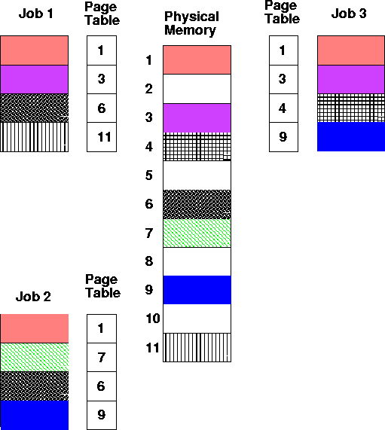
Shared Pages

Slide 35
Segmentation לעבור לשקף הבא להסבר
Memory Management Scheme that supports user view of memory.
A program is a collection of segments.
A segment is a logical unit such as
      main program, procedure, function
      local variables, global variables,common block
      stack, symbol table, arrays
    Protect each entity independently
    Allow each segment to grow independently
    Share each segment independently

Slide 36
Logical view of segmentation
1
2
1
4
2
4
3
3
User Space
Physical Memory

Slide 37
Segmentation Architecture
  Logical address consists of a two tuple
      <segment-number, offset>
  Segment Table
    Maps two-dimensional user-defined addresses into one-dimensional physical addresses. Each table entry has
      Base - contains the starting physical address where the segments reside in memory.
      Limit - specifies the length of the segment.
    Segment-table base register (STBR) points to the segment table’s location in memory.
    Segment-table length register (STLR) indicates the number of segments used by a program; segment number is legal if s < STLR.

Slide 38
Segmentation Architecture (cont.)
  Relocation is dynamic - by segment table
  Sharing
    Code sharing occurs at the segment level.
    Shared segments must have same segment number.
  Allocation - dynamic storage allocation problem
    use best fit/first fit, may cause external fragmentation.
  Protection
    protection bits associated with segments
      read/write/execute privileges
      array in a separate segment - hardware can check for illegal array indexes.

Slide 39
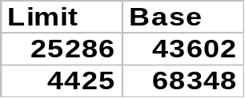
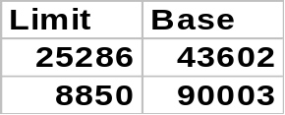
Shared segments
editor
0
segment 0
1
43062
data 1
Segment Table
process P1
editor
68348
data 1
data 1
segment 1
72773
Logical Memory
process P1
editor
90003
data 2
0
data 2
segment 0
1
98553
Segment Table
process P2
Logical Memory
process P2
segment 1

Slide 40
Segmented Paged Memory
  Segment-table entry contains not the base address of the segment, but the base address of a page table for this segment.
    Overcomes external fragmentation problem of segmented memory.
    Paging also makes allocation simpler; time to search for a suitable segment (using best-fit etc.) reduced.
    Introduces some internal fragmentation and table space overhead.
  Multics - single level page table
  IBM OS/2 - OS on top of Intel 386
    uses a two level paging scheme

Slide 41
Multics
S | P | d
S – מספר סגמנט
P – מספר הדף בסגמנט
d – ההיסט בתוך הדף
A
0 | 3 | 5
0
1
2
3 | 24
5
8
3
...
7
9
1

Slide 42
Multics
S | P | d
S – מספר סגמנט
P – מספר הדף בסגמנט
d – ההיסט בתוך הדף
הדף נמצא בתא מספר 3 בטבלת הדפים של הסגמנט
תא מספר 0 בטבלת הסגמנטים
תא מספר 5 בדף/במסגרת
A
0 | 3 | 5
0
1
2
3 | 24
5
8
3
...
7
9
1

Slide 43
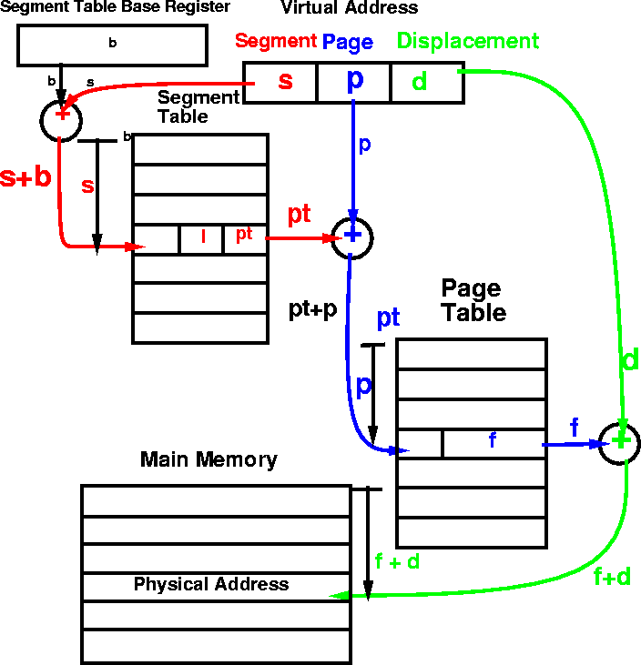
MULTICS address translation scheme

Slide 44
Virtual Memory
Background
Demand paging
  Performance of demand paging
Page Replacement
  Page Replacement Algorithms
Allocation of Frames
Thrashing
Demand Segmentation

Slide 45
Need for Virtual Memory
Virtual Memory
    Separation of user logical memory from physical memory.
    Only PART of the program needs to be in memory for execution.
    Logical address space can therefore be much larger than physical address space.
    Need to allow pages to be swapped in and out.
Virtual Memory can be implemented via
  Paging
  Segmentation

Slide 46
Paging/Segmentation Policies
Fetch Strategies
    When should a page or segment be brought into primary memory from secondary (disk) storage?
      Demand Fetch
      Anticipatory Fetch
Placement Strategies
    When a page or segment is brought into memory, where is it to be put?
      Paging - trivial
      Segmentation - significant problem
Replacement Strategies
    Which page/segment should be replaced if there is not enough room for a required page/segment?

Slide 47
Demand Paging
Bring a page into memory only when it is needed.
      Less I/O needed
      Less Memory needed
      Faster response
      More users
The first reference to a page will trap to OS with a page fault.
OS looks at another table to decide
      Invalid reference - abort
      Just not in memory.

Slide 48
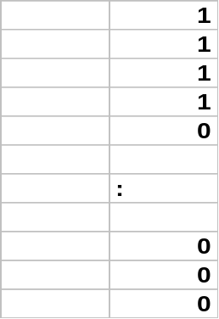
Valid-Invalid Bit
  With each page table entry a valid-invalid bit is associated (1 ⇒ in-memory, 0 ⇒ not in memory).
  Initially, valid-invalid bit is set to 0 on all entries.
    During address translation, if valid-invalid bit in page table entry is 0 --- page fault occurs.
    Example of a page-table snapshot
Frame #
Valid-invalid bit
Page Table

Slide 49
Handling a Page Fault
  Page is needed - reference to page
      Step 1: Page fault occurs - trap to OS (process suspends).
      Step 2: Check if the virtual memory address is valid. Kill job if invalid reference. If valid reference, and page not in memory, continue.
      Step 3: Bring into memory - Find a free page frame, map address to disk block and fetch disk block into page frame. When disk read has completed, add virtual memory mapping to indicate that page is in memory.
      Step 4: Restart instruction interrupted by illegal address trap. The process will continue as if page had always been in memory.

Slide 50
What happens if there is no free frame?
Page replacement - find some page in memory that is not really in use and swap it.
    Need page replacement algorithm
    Performance Issue - need an algorithm which will result in minimum number of page faults.
  Same page may be brought into memory many times.

Slide 51
Performance of Demand Paging
Page Fault Ratio - 0 ≤ p ≤ 1.0
  If p = 0, no page faults
  If p = 1, every reference is a page fault
Effective Access Time
    EAT = (1-p) * memory-access +
    p * (page fault overhead +
    swap page out +
    swap page in +
    restart overhead)

Slide 52
Demand Paging Example
Memory Access time = 1 microsecond
50% of the time the page that is being replaced has been modified and therefore needs to be swapped out.
Swap Page Time = 10 msec = 10,000 microsec
  EAT = (1-p) *1 + p (15000) ≈1 + 15000p microsec
EAT is directly proportional to the page fault rate.

Slide 53
Page Replacement
Prevent over-allocation of memory by modifying page fault service routine to include page replacement.
Use modify(dirty) bit to reduce overhead of page transfers - only modified pages are written to disk.
Page replacement
    large virtual memory can be provided on a smaller physical memory.

Slide 54
Page Replacement Algorithms
Want lowest page-fault rate.
Evaluate algorithm by running it on a particular string of memory references (reference string) and computing the number of page faults on that string.
Assume reference string in examples to follow is
    1, 2, 3, 4, 1, 2, 5, 1, 2, 3, 4, 5.

Slide 55
Page Replacement Strategies
    The Principle of Optimality
      Replace the page that will not be used again the farthest time into the future.
    Random Page Replacement
      Choose a page randomly
    FIFO - First in First Out
      Replace the page that has been in memory the longest.
    LRU - Least Recently Used
      Replace the page that has not been used for the longest time.
    LFU - Least Frequently Used
      Replace the page that is used least often.
    NUR - Not Used Recently
      An approximation to LRU
    Working Set
      Keep in memory those pages that the process is actively using

Slide 56
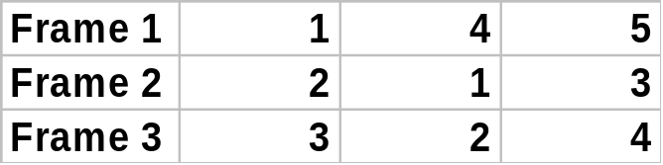
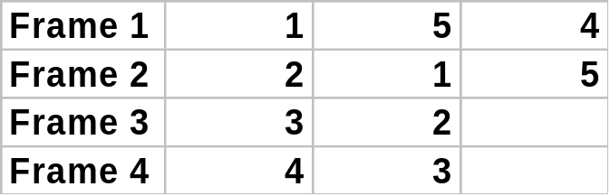
First-In-First-Out (FIFO) Algorithm
  Reference String: 1,2,3,4,1,2,5,1,2,3,4,5
Assume x frames ( x pages can be in memory at a time per process)
3 frames
9 Page faults
10 Page faults
4 frames
FIFO Replacement - Belady’s Anomaly -- more frames does not mean less page faults

Slide 57
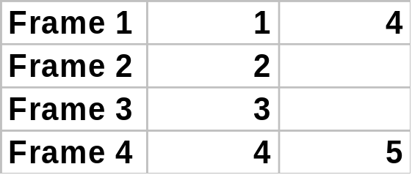
Optimal Algorithm
Replace page that will not be used for longest period of time.
  How do you know this???
  Generally used to measure how well an algorithm performs.
6 Page faults
4 frames

Slide 58
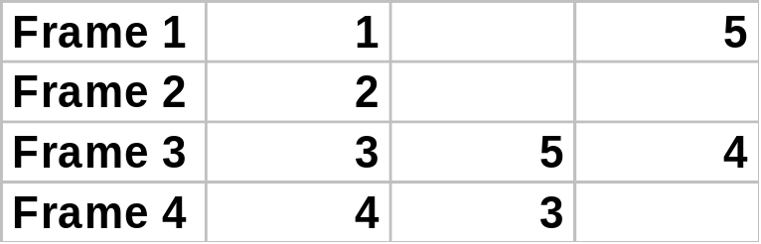
Least Recently Used (LRU) Algorithm
  Use recent past as an approximation of near future.
  Choose the page that has not been used for the longest period of time.
  May require hardware assistance to implement.
  Reference String: 1,2,3,4,1,2,5,1,2,3,4,5
4 frames
8 Page faults

Slide 59
Implementation of LRU algorithm
Counter Implementation
      Every page entry has a counter; every time page is referenced through this entry, copy the clock into the counter.
      When a page needs to be changes, look at the counters to determine which page to change (page with smallest time value).
Stack Implementation
    Keeps a stack of page number in a doubly linked form
    Page referenced
      move it to the top
      required 6 pointers to be changed
    No search required for replacement

Slide 60
LRU Approximation Algorithms
  Reference Bit
      With each page, associate a bit, initially = 0.
      When page is referenced, bit is set to 1.
      Replace the one which is 0 (if one exists). Do not know order however.
  Additional Reference Bits Algorithm
      Record reference bits at regular intervals.
      Keep 8 bits (say) for each page in a table in memory.
      Periodically, shift reference bit into high-order bit, I.e. shift other bits to the right, dropping the lowest bit.
      During page replacement, interpret 8bits as unsigned integer.
      The page with the lowest number is the LRU page.

Slide 61
LRU Approximation Algorithms
  Second Chance
    FIFO (clock) replacement algorithm
    Need a reference bit.
    When a page is selected, inspect the reference bit.
    If the reference bit = 0, replace the page.
    If page to be replaced (in clock order) has reference bit = 1, then
      set reference bit to 0
      leave page in memory
      replace next page (in clock order) subject to same rules.

Slide 62
LRU Approximation Algorithms
  Enhanced Second Chance
    Need a reference bit and a modify bit as an ordered pair.
    4 situations are possible:
      (0,0) - neither recently used nor modified - best page to replace.
      (0,1) - not recently used, but modified - not quite as good, because the page will need to be written out before replacement.
      (1,0) - recently used but clean - probably will be used again soon.
      (1,1) - probably will be used again, will need to write out before replacement.
      Used in the Macintosh virtual memory management scheme

Slide 63
Counting Algorithms
Keep a counter of the number of references that have been made to each page.
  LFU (least frequently used) algorithm
    replaces page with smallest count.
    Rationale : frequently used page should have a large reference count.
      Variation - shift bits right, exponentially decaying count.
  MFU (most frequently used) algorithm
    replaces page with highest count.
    Based on the argument that the page with the smallest count was probably just brought in and has yet to be used.

Slide 64
Page Buffering Algorithm
Keep pool of free frames
    Solution 1
      When a page fault occurs, choose victim frame.
      Desired page is read into free frame from pool before victim is written out.
      Allows process to restart soon, victim is later written out and added to free frame pool.
    Solution 2
      Maintain a list of modified pages. When paging device is idle, write modified pages to disk and clear modify bit.
    Solution 3
      Keep frame contents in pool of free frames and remember which page was in frame.. If desired page is in free frame pool, no need to page in.

Slide 65
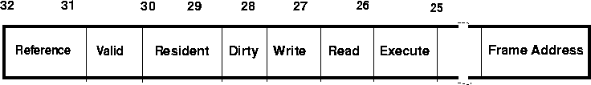
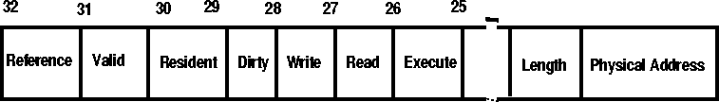
Protection Bits
Page Protection
Segmentation Protection
Reference - Page has been accessed
Valid - Page exists
Resident - Page is cached in primary memory
Dirty - Page has been changed since page in

Slide 66
Allocation of Frames
  Single user case is simple
      User is allocated any free frame
  Problem: Demand paging + multiprogramming
    Each process needs minimum number of pages based on instruction set architecture.
    Example IBM 370: 6 pages to handle MVC (storage to storage move) instruction
      Instruction is 6 bytes, might span 2 pages.
      2 pages to handle from.
      2 pages to handle to.
    Two major allocation schemes:
      Fixed allocation
      Priority allocation

Slide 67
Fixed Allocation
Equal Allocation
      E.g. If 100 frames and 5 processes, give each 20 pages.
Proportional Allocation
    Allocate according to the size of process
      Sj = size of process Pj
      S = ∑Sj
      m = total number of frames
      aj = allocation for Pj = Sj/S * m
      If m = 64, S1 = 10, S2 = 127 then
      a1 = 10/137 * 64 ≈ 5
      a2 = 127/137 * 64 ≈ 59

Slide 68
Priority Allocation
May want to give high priority process more memory than low priority process.
Use a proportional allocation scheme using priorities instead of size
If process Pi generates a page fault
    select for replacement one of its frames
    select for replacement a frame form a process with lower priority number.

Slide 69
Global vs. Local Allocation
Global Replacement
    Process selects a replacement frame from the set of all frames.
    One process can take a frame from another.
    Process may not be able to control its page fault rate.
Local Replacement
    Each process selects from only its own set of allocated frames.
    Process slowed down even if other less used pages of memory are available.
Global replacement has better throughput
    Hence more commonly used.

Slide 70
Thrashing
If a process does not have enough pages, the page-fault rate is very high. This leads to:
    low CPU utilization.
    OS thinks that it needs to increase the degree of multiprogramming
    Another process is added to the system.
    System throughput plunges...
  Thrashing
    A process is busy swapping pages in and out.
    In other words, a process is spending more time paging than executing.

Slide 71
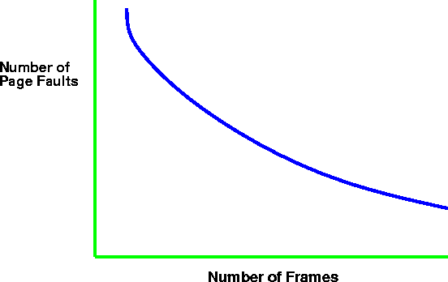
Thrashing (cont.)
  Why does paging work?
      Locality Model - computations have locality!
      Locality - set of pages that are actively used together.
      Process migrates from one locality to another.
      Localities may overlap.

Slide 72
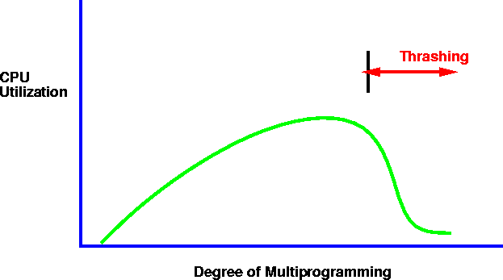
Thrashing
  Why does thrashing occur?
    ∑ (size of locality) > total memory size

Slide 73
Working Set Model
Δ ≡ working-set window
    a fixed number of page references, e.g. 10,000 instructions
  WSSj (working set size of process Pj) - total number of pages referenced in the most recent Δ (varies in time)
    If Δ too small, will not encompass entire locality.
    If Δ too large, will encompass several localities.
    If Δ = ∞, will encompass entire program.
  D = ∑ WSSj ≡ total demand frames
    If D > m (number of available frames) ⇒thrashing
  Policy: If D > m, then suspend one of the processes.

Slide 74
Keeping Track of the Working Set
Approximate with
    interval timer + a reference bit
  Example: Δ = 10,000
      Timer interrupts after every 5000 time units.
      Whenever a timer interrupts, copy and set the values of all reference bits to 0.
      Keep in memory 2 bits for each page (indicated if page was used within last 10,000 to 15,000 references).
      If one of the bits in memory = 1 ⇒ page in working set.
    Not completely accurate - cannot tell where reference occurred.
    Improvement - 10 bits and interrupt every 1000 time units.

Slide 75
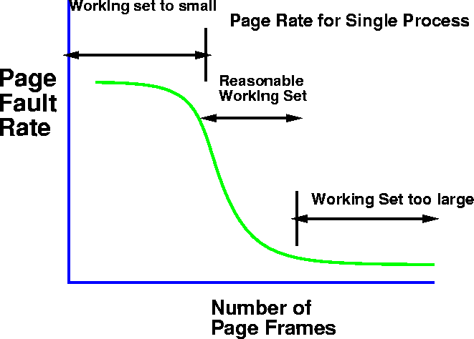
Page fault Frequency Scheme
    Control thrashing by establishing acceptable page-fault rate.
      If page fault rate too low, process loses frame.
      If page fault rate too high, process needs and gains a frame.

Slide 76
Demand Paging Issues
  Prepaging
    Tries to prevent high level of initial paging.
      E.g. If a process is suspended, keep list of pages in working set and bring entire working set back before restarting process.
      Tradeoff - page fault vs. prepaging - depends on how many pages brought back are reused.
  Page Size Selection
    fragmentation
    table size
    I/O overhead
    locality

Slide 77
Demand Paging Issues
  Program Structure
    Array A[1024,1024] of integer
    Assume each row is stored on one page
    Assume only one frame in memory
    Program 1
      for j := 1 to 1024 do
      for i := 1 to 1024 do
      A[i,j] := 0;
      1024 * 1024 page faults
    Program 2
      for i := 1 to 1024 do
      for j:= 1 to 1024 do
      A[i,j] := 0;
      1024 page faults

Slide 78
Demand Paging Issues
I/O Interlock and addressing
    Say I/O is done to/from virtual memory. I/O is implemented by I/O controller.
      Process A issues I/O request
      CPU is given to other processes
      Page faults occur - process A’s pages are paged out.
      I/O now tries to occur - but frame is being used for another process.
    Solution 1: never execute I/O to memory - I/O takes place into system memory. Copying Overhead!!
    Solution 2: Lock pages in memory - cannot be selected for replacement.

Slide 79
Demand Segmentation
Used when there is insufficient hardware to implement demand paging.
OS/2 allocates memory in segments, which it keeps track of through segment descriptors.
    Segment descriptor contains valid bit to indicate whether the segment is currently in memory.
      If segment is in main memory, access continues.
      If not in memory, segment fault.

